Slide 1
Principles of Management (MS 731)
by
Dr. Subhadip Sarkar
ASST PROFESSOR
DMS NIT DGP

Slide 3
TOPICS TO BE COVERED
BASIC DEFINITIONS OF MANAGEMENT & BUSINESS
THREE LEVELS OF IT AND VARIOUS AREAS OF DECISION MAKING
VARIOUS MANAGERIAL APPROACHES
MANAGERIAL FUNCTIONS
BUSINESS ENVIRONMENT & ITS COMPONENTS
TASK ENVIRONMENT
INDUSTRY ANALYSIS WITH AN EXAMPLE
GENERIC ENVIRONMENT & PESTLE ANALYSIS

Slide 4
Principles
Certain rules which can define the behavior of a system
Exploration of proposition, knowledge and concept which are able to define and explain the physical evidences.
Knowledge is a familiarity, awareness or understanding of someone or something, such as facts, information, descriptions, or skills, which is acquired through experience or education by perceiving, discovering, or learning.
A concept is an abstract idea representing the fundamental characteristics of what it represents. It represents categories exclusively in terms of perceivable qualities and relations. They arise as abstractions or generalisations from experience or the result of a transformation of existing ideas (TO SERVE CERTAIN PURPOSE, FOR EXAMPLE, CHATURASHRAM).

Slide 5
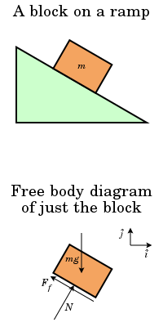
FOR EXAMPLE: THE CONCEPT OF FREE BODY DIAGRAM
In physics and engineering, a free body diagram (force diagram, or FBD) is a graphical illustration used to visualize the applied forces, moments, and resulting reactions on a body in a given condition

Slide 6
What is EFA?
Factor analysis is statistical method used to measure the unobservable variables (which can be conceptualized as causal factors which remain hidden) through a larger number of observable variables (symptomatic or manifested variables) on which they have an intense impact.
EFA is a statistical technique that is used to reduce data to a smaller set of summary variables and to explore the underlying theoretical structure of the phenomena.
EFA was developed by Charles Spear-man's work in 1904. The underlying theory was developed by Thurstone and Thomson.
Temperature
Service
Freshness of the food
Food quality
Service quality
Cleanliness
Taste of the food
Presentation
Price
Customer satisfaction

Slide 7
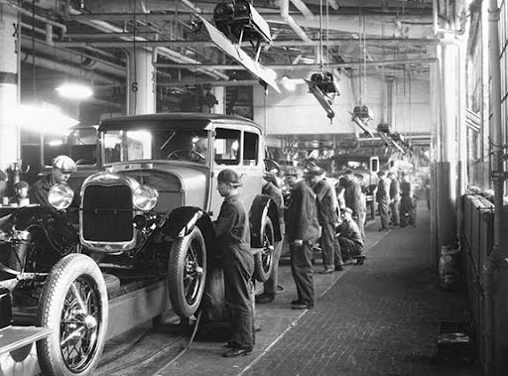
EXAMPLE OF AN AVERAGE WORKER AND A QUALIFIED WORKER
A qualified worker is one who is ACCEPTED as having the necessary PHYSICAL ATTRIBUTES, INTELLIGENCE AND EDUCATION and ACQUIRED SKILL and knowledge to carry out the WORK to a SATISFATORY STANDARDS OF SAFETY, QUALITY AND QUANTITY.
REASON:
TO PRODUCE A quality PRODUCT AT A faster RATE. TO Reward THE worker With Several BENEFITS

Slide 8
Introduction
The Term ‘Business’ means all those human activities which are performed for making profits. Business includes purchase of goods with the object of selling them at profit.
A business, known as an enterprise or a firm, is an ORGANIZATION involved in the TRADE of GOODS, SERVICE, or both to CUSTOMERS.
Trade, also called goods exchange economy, is to TRANSFER the OWNERSHIP of goods from one person or entity to another by getting something in exchange from the BUYER..
Salient points noticed for any business:
Deals in goods and services;
Sale of exchange of goods and services;
Requires investment;
Aims at earning profit but involves risk and uncertainty of income
Broad objectives:
Economic,
Social and for Human
National Objectives
Global Objectives

Slide 9
Economic Concept of Flow of Resources
A cyclic rotation?
Extraction
Natural Resources
Raw material
human
Human utilization
Production
Money
Money
Firm
Profit
m
Explores
Finished Goods
Human Need

Slide 10
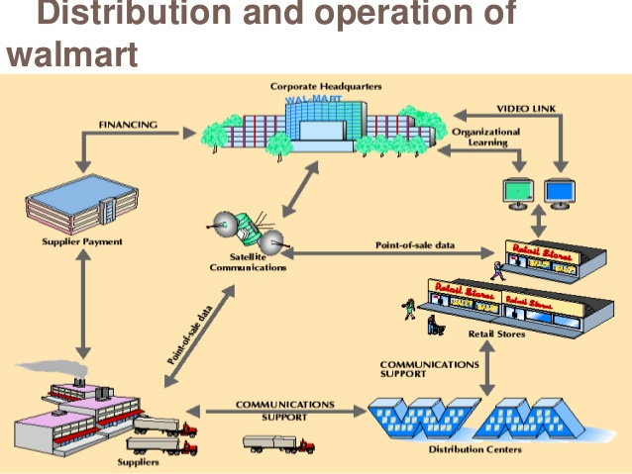

Slide 11
What is management & how does it get related with the business?
MANAGEMENT IS The STUDY FOR CONDUCTING THE OPERATIONS OF A BUSINESS efficiently and effectively.
Management is a process of designing and maintaining an environment in which an individual can work with others to achieve a desired goal.
MANAGEMENT consists of getting things by others. Managers are those who accomplishes the objectives through directing the efforts of others: By S. George
Management is the process of utilizing the organizational resources to achieve a set of goals by planning, organizing, leading & controlling.

Slide 12
Concept of Productivity, Effectiveness and Efficiency
Effectiveness: doing the right things. Doing those activities which can drive to achieve the desired goals. It concerns with the ends or achievement of goals
Efficiency: doing the things right. Resources are used economically. It stresses on the means of getting the things done. It always seeks a better method which can eliminate wastes.
Productivity: It is a development of an attitude of mind to find better, safer, easier means of doing a job. It means the reduction in the wastage of resources. It is the ratio of production of a commodity in volume and one or more input factors also measured by the same unit.
Lean Principles to reduce waste: 1. over-production, 2. over processing, 3. excess movement of products, 4. motion (during a task), 5. waiting time for m/c or job, 6. defects 7. inventory and 8. skills

Slide 13
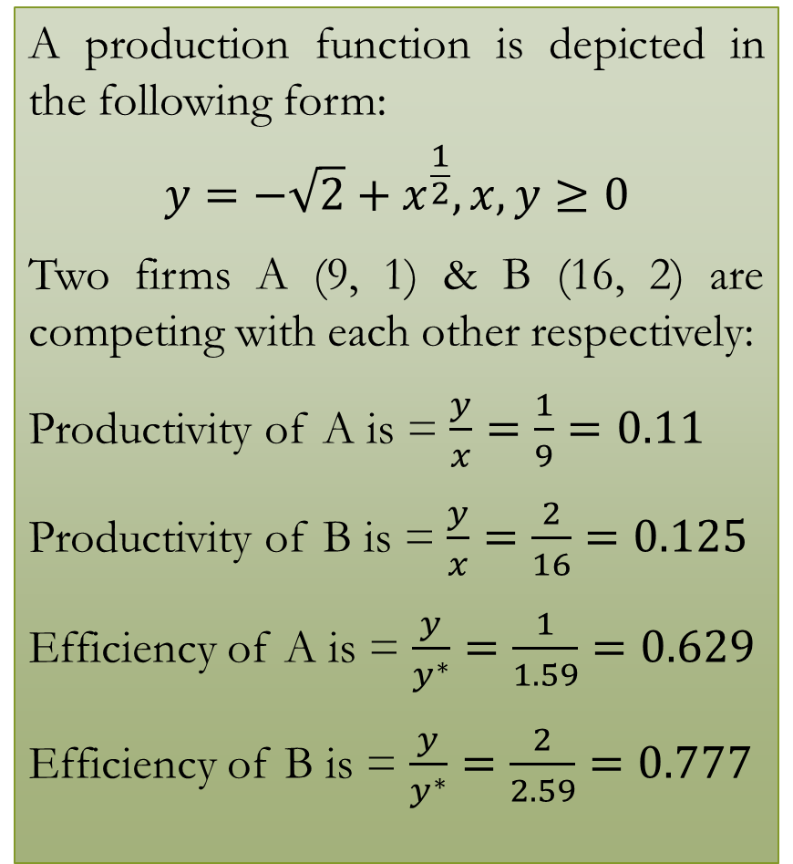
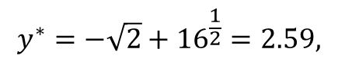
Who is the winner? How much a loser has to improve?
A production function is depicted in the following form:
$$y=−\sqrt{2}+x^{\frac{1}{2}},x,y≥0$$
Two firms A (9, 1) & B (16, 2) are competing with each other respectively:
Productivity of A is = $\frac{y}{x}=\frac{1}{9}=0.11$
Productivity of B is = $\frac{y}{x}=\frac{2}{16}=0.125$
Efficiency of A is = $\frac{y}{y^{∗}}=\frac{1}{1.59}=0.629$
Efficiency of B is = $\frac{y}{y^{∗}}=\frac{2}{2.59}=0.777$
Input | Output
2 | 0.00
3 | 0.32
4 | 0.59
5 | 0.83
6 | 1.04
7 | 1.24
8 | 1.42
9 | 1.59
10 | 1.75
11 | 1.91
12 | 2.05
13 | 2.2
14 | 2.33
15 | 2.46
16 | 2.59
17 | 2.71
18 | 2.83
19 | 2.95
20 | 3.06
(16, 2.59)
B (16, 2)
A (9, 1)
$$y^{∗}=−\sqrt{2}+{16}^{\frac{1}{2}}=2.59,$$

Slide 14
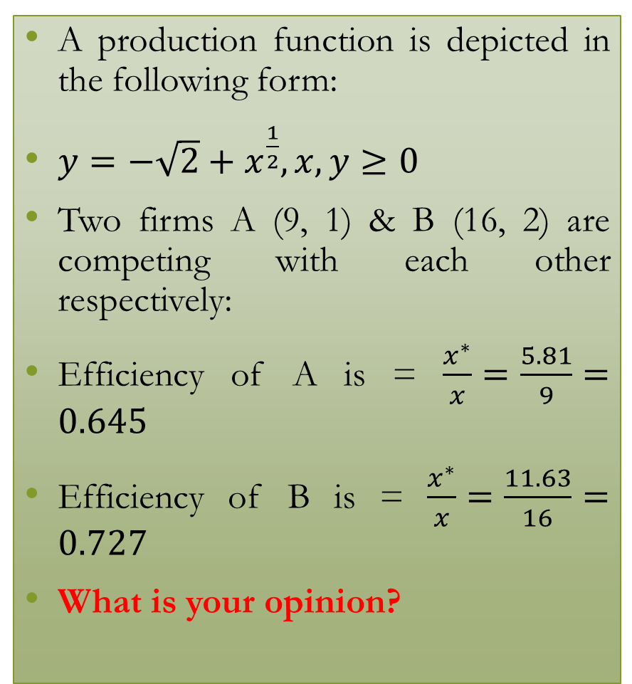
Who is the winner? How much a loser has to improve?
A production function is depicted in the following form:
$y=−\sqrt{2}+x^{\frac{1}{2}},x,y≥0$
Two firms A (9, 1) & B (16, 2) are competing with each other respectively:
Efficiency of A is = $\frac{x^{∗}}{x}=\frac{5.81}{9}=0.645$
Efficiency of B is = $\frac{x^{∗}}{x}=\frac{11.63}{16}=0.727$
What is your opinion?
Input | Output
2 | 0.00
3 | 0.32
4 | 0.59
5 | 0.83
6 | 1.04
7 | 1.24
8 | 1.42
9 | 1.59
10 | 1.75
11 | 1.91
12 | 2.05
13 | 2.2
14 | 2.33
15 | 2.46
16 | 2.59
17 | 2.71
18 | 2.83
19 | 2.95
20 | 3.06
(16, 2.59)
B (16, 2)
A (9, 1)
$$y^{∗}=−\sqrt{2}+{16}^{\frac{1}{2}}=2.59,$$

Slide 15
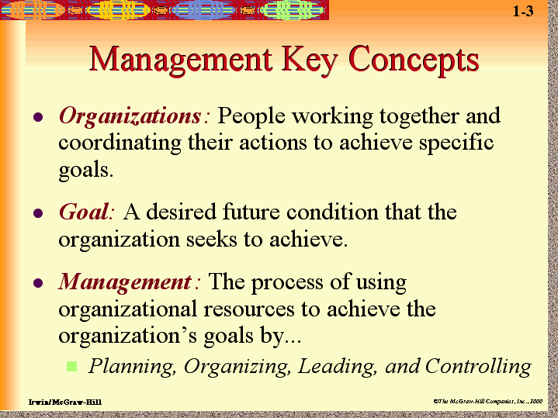
What managers do?
A manager is one who has his or her responsibility of taking actions to make it possible for individuals to contribute in a best way towards the ultimate goal.
Managers carry out functions like planning, organizing, staffing, leading and controlling. By Koontz
Managers are those who accomplishes the objectives through directing the efforts of others: By S. George
Technical (to perform a specialized task): knowledge about the job specific procedure and efficient way to solve it,
Interpersonal (helps to work with the subordinates): mentoring, leading, directing, liaison, communication
Conceptual (to imagine a situation and decide): problem identification, analyze, understand, being creative, concept formulation
Which skills do they need?

Slide 16
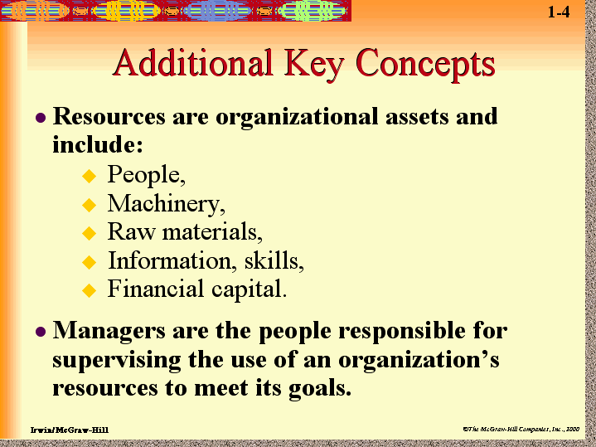
Managers perform management for the organization
Organization | Purpose | Resources
Textile | Production of cloth, garments, shipping, packing, | "ZARA Textile is devoted to achieve consistent improvement in the system of providing products & services to the customers through On Time Delivery & Enhancing Customers Satisfaction by means of Quality and Value."
School | Imparting knowledge | staff, student, teacher, administrators, fund, school building, library, computers & other facilities
State Government | wellbeing of people | chief ministers to city municipality chairman, storages of essential crops, fund, infrastructure (land, road, offices),
An organization (with 2 or more persons) is a STRUCTURE of Roles to fulfill a set of common purposes

Slide 17
Flow Inside the Firm
Components of business
Manager
Service, knowledge
Salary
Wage
Labor
Labor, skill
Product
Money
Supplier
Service
Money
Subcontractor
Service
Revenue
Money
Contractor, service provider
Return
Financer
Investment
Profit
Owners
Investment

Slide 18
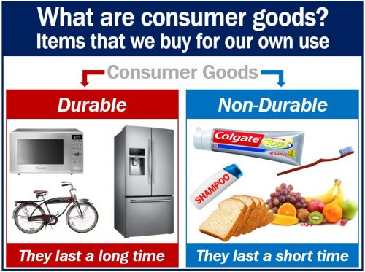
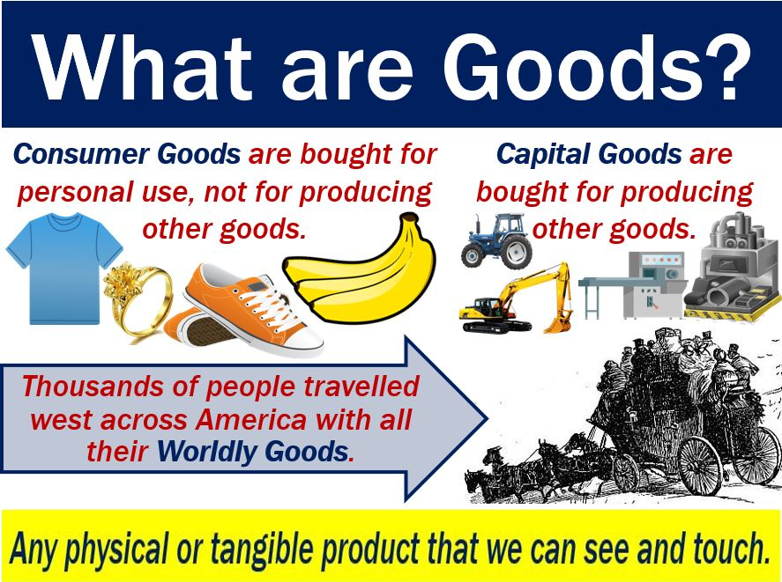
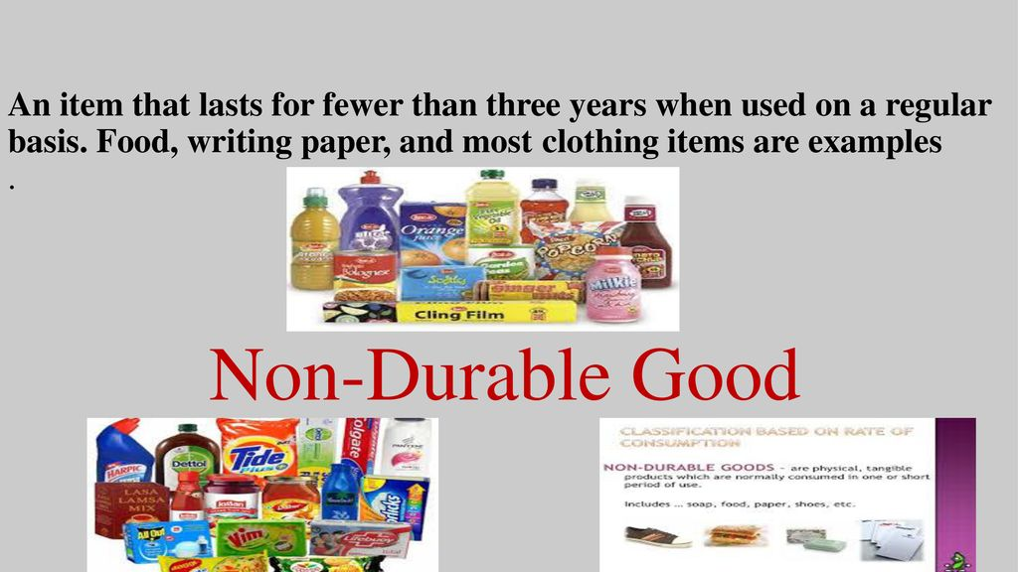
What is a Product?
A product is anything that can be offered to satisfy a want or need. It can include any physical product, service, events, persons, places, properties, organizations, information and idea.
A need is the basic human requirement for ensuring the survival like food, air, water, shelter. A Need becomes want when it is directed to a specific product which can satisfy the need.

Slide 19
Service system
A service is the performance made by one to another which is essentially intangible in nature and does not result ownership of any thing. Its production may or may not be tied up with a physical product.
Intangibility (abstract in nature): Products have tangible qualities that provide information to consumers so they can easily compare one product to another.
Heterogeneity (services are non standard): Manufactured goods tend to have automated processes and quality assurance procedures that result in a consistent product.
Inseparability (consumed at the time of production): The Physical presence of the service provider and the customer becomes an integral part of the service itself.
Perishability (not possible to store): Services are often perishable and the unused capacity cannot be stored for future use or sale.

Slide 20
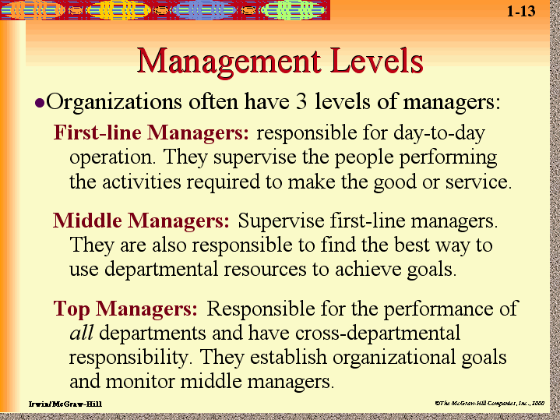
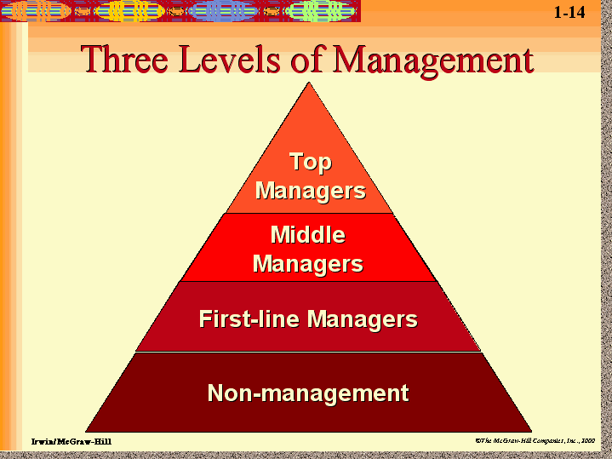

Slide 21
Why DO WE SEE ONLY three levels?
Top level
Middle level
First level
Vision and mission, quality strategy, expansion, capacity decision (5% of Performance)
Resource allocation (most important today ex: Toyota 24%) designer’s role was important (makes ideas into reality & team building)
Execution and control
WHETHER TO INSTALL MID-SIZED PLANTS IN A CERTAIN GAP OF YEARS OR ONE LARGE PLANT AT A TIME
HOW MANY WORKERS WILL BE REQUIRED, HOW MUCH INVENTORY WILL BE KEPT
WHICH MACHINE IS TO BE USED AND WHAT TYPE OF JOBS WILL BE LOADED
Notes:
Strategic leaders need to ensure that their organizations have three types of aims. A vision states what the organization aspires to become in the future. A mission reflects the organization’s past and present by stating why the organization exists and what role it plays in society. Goals are the more specific aims that organizations pursue to reach their visions and missions.

Slide 22
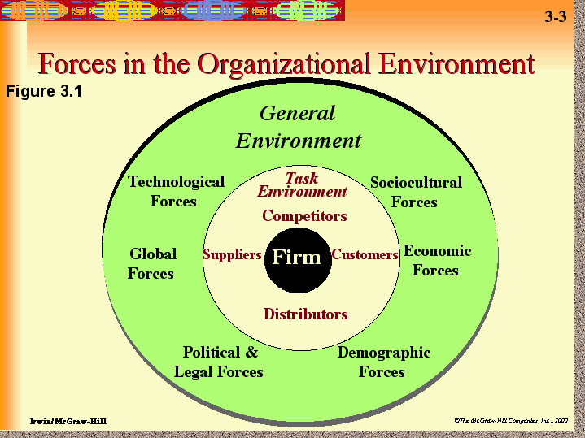
External Environment
“The total of all things external to firms and industries that affect the function of the organization is called business environment.”
Competitors
Customers
Suppliers
Public
Marketing intermediaries
Workers and Union
“It encompasses the ‘climate’ or set of conditions, economic, social, political or institutional in which business operations are conducted.”
Economic Environment
Socio-Cultural Environment
Geographical Environment
Ecological Environment
Demographic Environment
Technological
Political and Government
Legal environment
When any technology is used in a business (when the automation is applied) on an efficient (inefficient) operation will magnify the efficiency (inefficiency).

Slide 23
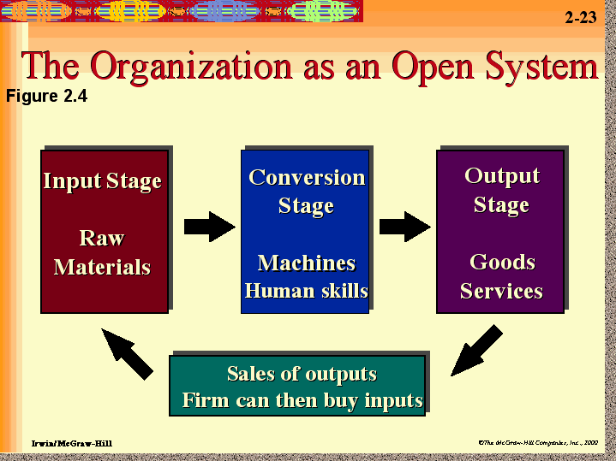
Schematic diagram
It can be defined as a user of resources to convert inputs into desired outputs.
location: Transportation (CUSTOMER TYPE)
Physical: manufacturing, RAW MATERIAL TYPE
Exchange: retail, (CUSTOMER TYPE)
Physiological: health care, (CUSTOMER TYPE)
Informational: telephone service, (INFORMATIONAL TYPE)
Storage: warehouse, RAW MATERIAL TYPE
Inputs
Re-
Energize
Planning
Organizing
Staffing
External environment
Communication
Leading
Controlling
Production of Goods
THREE LESSIONS:
“SOW WHAT YOU REAP”
“DO GOOD REAP GOOD”
“DO GOOD THE GOOD WILL FOLLOW YOU”

Slide 24
MANAGEMENT APPROACHES
CASE BASED: gaining experience through cases
CONTINGENCY: sees the impact of the given solution
MANAGEMENT SCIENCE: management is a logical process
TQM: focus is on the continuously improving process to produce a good or service which should be fit for use.
SYSTEMS: defines the boundary of the business & analyze the external effects and worth of the managerial functions
SOCIOTECHNICAL: identifies the effects of the technical and the social system
GROUP BEHVIOURAL: analysis of the group behavior through sociology and social psychology
MANAGERIAL ROLES: analysis of what managers do
DECISION THEORY: how the individual and group decisions are made with the help of the information.
INTERPERSONAL: ignores planning, organizing etc and focuses on the interpersonal behavior, leadership and motivation

Slide 25
Mystery of success
Good leadership to ensure the proper direction of thrive
Proper balance in centralized & decentralized decisions
To establish a standard operating procedure and to keep a standard condition.
Focus on the core business operations and aiming to be excellent.
Keep vigil on customers and proper future planning.
Proper employee recruitment and selection to preserve good talent. Encourage new concepts and undying spirit.

Slide 26
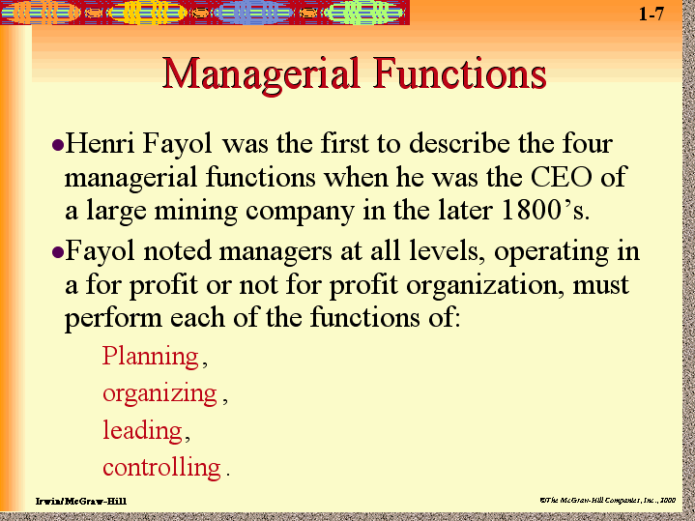

Slide 27
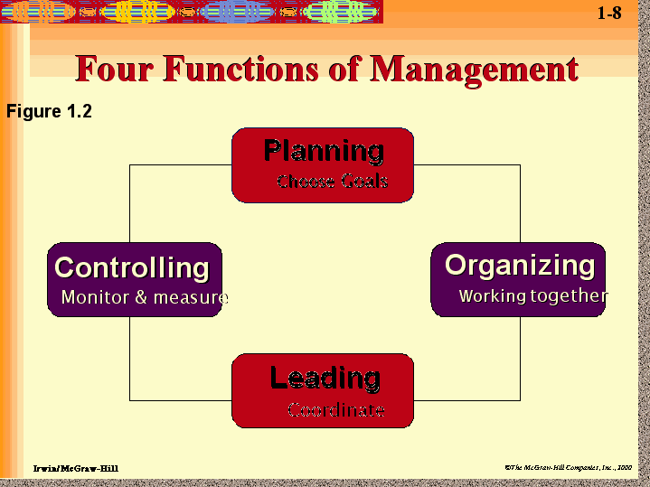
Which has to performed efficiently

Slide 28
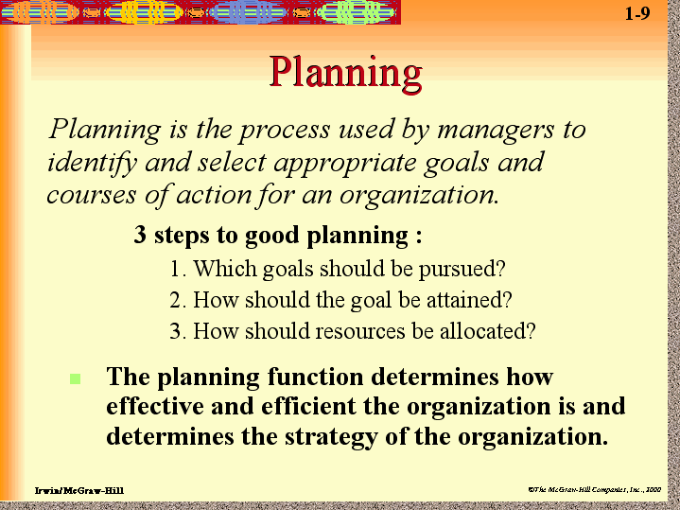

Slide 29
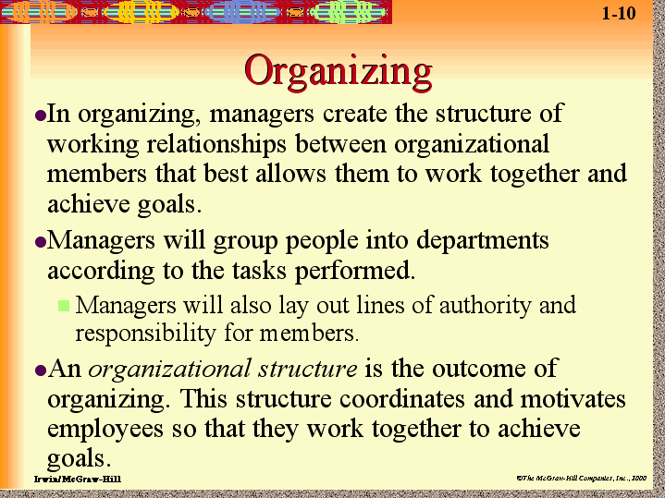

Slide 30
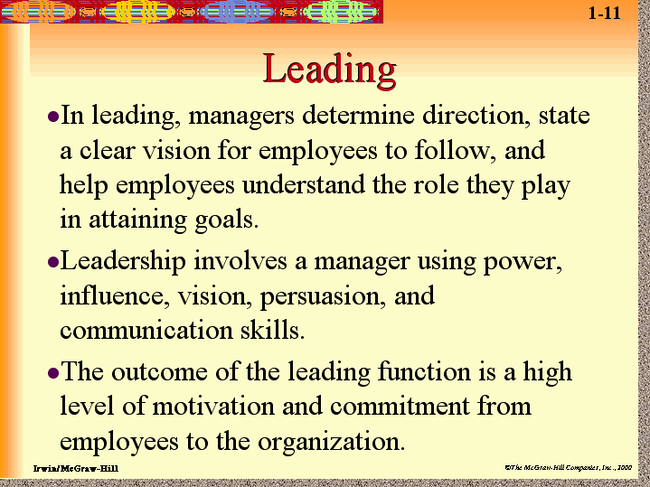

Slide 31
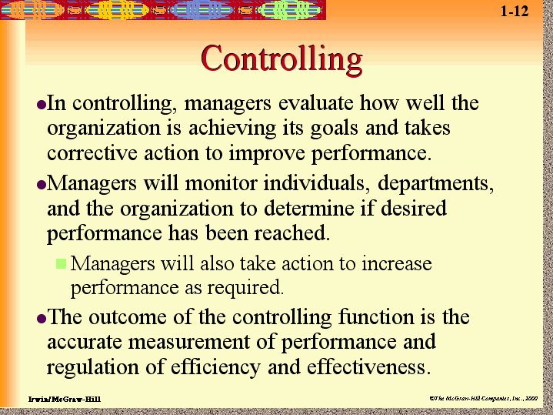

Slide 32
Functions with Time scale

Slide 33
Business Environment
By
Dr Subhadip Sarkar
DMS NIT DGP

Slide 34
Definition of Business Environment
The Term ‘Business’ means all those human activities which are performed for making profits. Business includes purchase of goods with the object of selling them at profit.
“Business Environment encompasses the ‘climate’ or set of conditions, economic, social, political or institutional in which business operations are Conducted.”–Arthur. M.Weimer
“The total of all things external to firms and industries that affect the function of the organization is called business environment.” – Wheeler

Slide 36
External Environment
The external environment consists of all the factors which provide opportunities or pose threats to an organization.
Competitors
Customers
Suppliers
Public
Marketing intermediaries
Workers and Union
Economic Environment
Non-Economic Environment
Socio-Cultural Environment
Natural Environment
Geographical Environment
Ecological Environment
Demographic Environment
Physical and Technological
Political and Government
Legal environment

Slide 37
Contemporary Business Environment & challenges
Unlike erstwhile environment now BE is dynamic. Technological (artificial intelligence, machine learning, and robotics), Economical and Societal changes are severe.
Managerial professional competences which are the union of the set of knowledge, skills and abilities of an individual, are directly related to the external environment.
Prahalad and Hamel (1990) equated the core competences of an organization as “collective learning of the organization”. Hence, Knowledge creation and the Development of managers’ competencies are important.
Managers’ competences are subjected to continuous adjustments due to changes in external environment and necessity to lead teams that are diversified in terms of locations and discipline.
Notes:
(Problem Solving, Critical Thinking, Creativity, People Management, Coordinating with Others, Emotional intelligence, Judgement and Decision making)

Slide 38
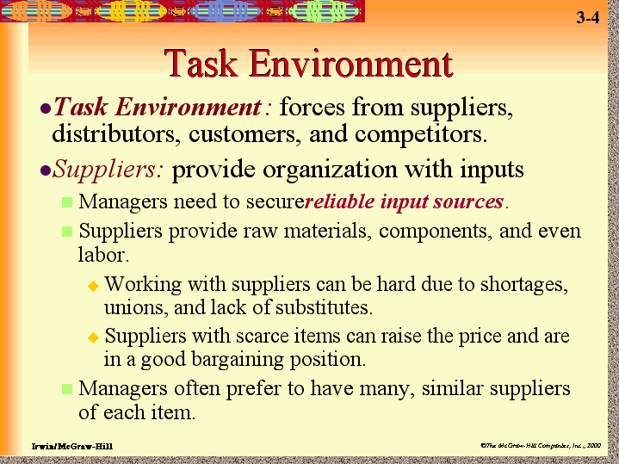
Notes:
Supplier is one who helps in providing raw materials, labors, investments, insurances, services in promotional activities etc.

Slide 39
Supplier Relationships
 | Adversary | Partnership
Tenure | Brief | Long-term, stable
Type of agreement | Sporadic purchase orders | Exclusive or semi-exclusive contracts, usually at least one year
Number of Sources | Several sources per item for protection against risk and for price competition | One or a few good suppliers for each item or commodity group
Prices/costs | High on average | Low; scale economics from volume contracts; suppliers can invest in improvements
Quality | Uncertain; reliance on receiving Inspections | Quality at source; supplier uses statistical process control and TQM
Design | Customer developed | Make use of suppliers’ design expertise
Delivery frequency / order size | Infrequent, large lot | Frequent (sometimes more than one per day), small lots just-in-time
Order Conveyance | Mail | Long-term: contracts. Short-term: KANBAN, phone, fax, or electronic data interchange

Slide 40
Few relevant factors are shown below
Quality | Inspection plans, Quality System, Rejection rate, Adherence to the Quality Tool
Delivery | Distribution capacity, Transportation cost, delivery commitments, Delivery-on time-every time, Safety and security of components, Modes of transportation facility
Production Capability | Change order capability, Meeting internal schedules, Forecasting, Production ramp up co-ordination, lead time, managing Inventory
Service | Spare parts availability, After sales service, Commitment to customer service
Technical Capability | Similar product experience, Understanding of technology, Engineering/ technical support resources
Price | Price deviation or differences, Quantity discount, Payment terms
Business Structure | Financial stability, Information systems, Contract terms

Slide 41
Value and Customer Perceived Value
An organized, creative cost search technique for analyzing the function of a product with the purpose of value enhancement without lowering its quality, performance & efficiency [by redesigning, adding new materials etc]
Maximum value is obtained when the essential function is achieved at minimum cost. Lowest cost to reliably provide the required function or service at the desired time and place and with the essential quality
It is a systematic application of techniques which identifies the function of product or a service, establish a monetary value for the function & provide the necessary function at the lowest overall cost.

Slide 42
Cont with value
It is an organized creative approach which has as its purpose the efficient identification of unnecessary cost [cost that does not contribute to the enhancement of Quality, Appearance, use]
In the year of 1776 Adams used this term to specify “value in use”
Walter (2002) used three attributes of it Quality [benefits to be received], Cost [payment in exchange], Schedule (at right time, quantity etc)

Slide 43
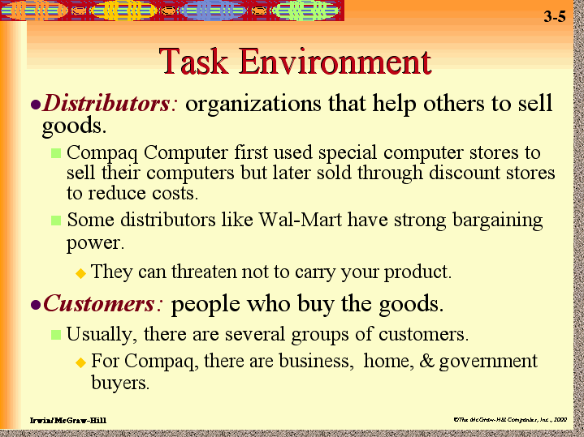

Slide 44
Customer Satisfaction
Customer is satisfied if the perceived performance of a product meets the expectation about it. Therefore, it is true that if the gap of performance & expectation is + then a customer may be satisfied.
Expectation can be realized from the marketers, friends, other competitors etc
If it is too high then there will be a high chance that customer will remain dissatisfied
However retention happens always at the highest level of satisfaction
Pick a market segment-get high Value Delivery System-offer value

Slide 45
Customer Loyalty & Retention
Strategies taken from the marketing executives like
Reactive (selling & encouraging questions), proactive (take suggestion from C), accountable (to ask about the performance of the product), partnership responses (work with others for improvement)
Platinum
Gold
Iron
Lead
Level of importance of a customer

Slide 46
Why?
Brand image
Affective loyalty
Service Quality
Customer satisfaction
Customer Retention
Product Quality
Cognitive loyalty
Value
Price
Affective loyalty: it describes the loyalty due to emotional basis
Cognitive loyalty: this is purely due to price, value & other functional aspects

Slide 47
Cont with value
According to Marketing principle it is dependent on quality, service and price
In an equation form of value = (benefits obtained / cost incurred)
Benefits from the product
Functional value
Service value
Personnel value
Image value
Costs incurred for the product
Price of the product
Time cost
Availability cost
Psychic cost

Slide 48
What is Value chain?
It is a collection of activities which generally augment the value of product
Primary activities
Inbound logistics
Operation
Outbound logistics
Marketing
After sales services
Secondary activities
Infrastructural activities
Human Resource
Technology
Material procurement related activity

Slide 49
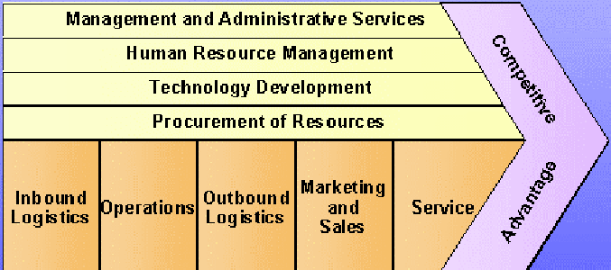
The Value Chain
Support
activities
Primary activities
Inbound logistics Materials receiving, storing, and distribution to manufacturing premises
Operations Transforming inputs into finished products.
Outbound logistics Storing and distributing products
Marketing and Sales Promotions and sales force
Service Service to maintain or enhance product value
Corporate infrastructure Support of entire value chain, e.g. general management planning,
financing, accounting, legal services, government affairs, and QM
Human resources management Recruiting, hiring, training, and development
Technology Development Improving product and manufacturing process
Procurement Purchasing input

Slide 50
WHAT IS SUPPLY CHAIN?
Supply chain or logistic network or a supply network is an integrated system of organization, information, resources and people, which is dedicated for moving a product or a service in physical or virtual manner from supplier’s supplier to customer.
Ss1
Ss2
Information flow
Sup
Material flow
Mfg
Flow of fund
R1
R2

Slide 51
Distributors & Retailers
One concerns with activities of selling goods to customers & nonbusiness people
Store [super store, specialty store, convenient stores] & Non-store (Direct Selling (chain of AMAY), Direct Marketing by tele-marketing, Vending machines) retailers try to assort product to influence people.
4 Strategies For retailers Tiffany [L-H], sunglass [L-L], Wall-mart [H-L], Bloomingdale (H-H)
Helps during purchase, flexibility of buying in any point of time
Sends in bulk but caters small orders
Excluding manufacturer, farmer & retailer those who are title takers and helps in distribution of the finished goods
Reasons of existence
Helps a remote mfg in distribution
Uses their own reputation for mfg
Takes the portion of theft, obsolescence
Gives space for storing materials

Slide 52
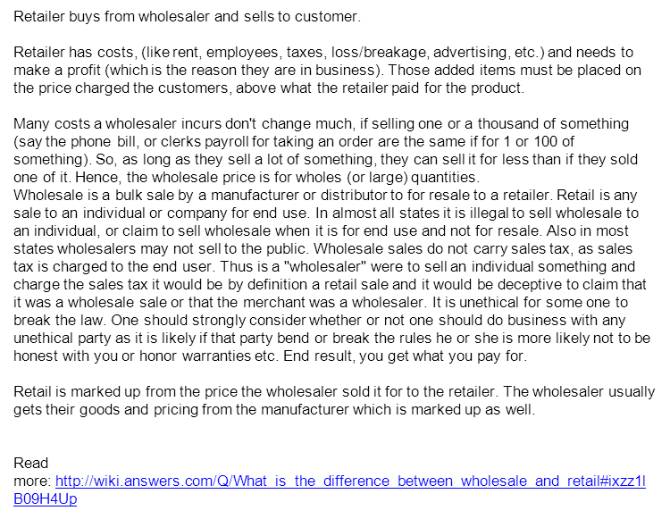

Slide 53
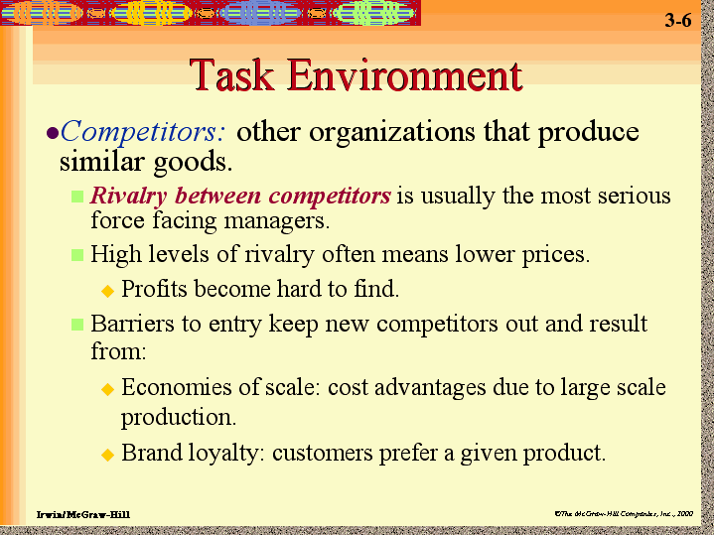

Slide 54
Competition
Four types of competition: brand (when companies compete with similar products), form (when companies compete with similar services), industrial (when companies within an industry compete), generic (competes for the dollar of the customer)
Type of Competition: Perfect [large number of buyers & sellers their interaction can decide on price, standard goods, information available for all competitive goods, Exit & Entry are very easy], Monopolistic, Oligopolistic competition,

Slide 55
A glimpse of Perfect Competition
Supply curve
Price of the
Product
Demand curve
Quantity

Slide 56
Meaning of MTP
A monopolistic trade practice is essentially a trade practice which represents the abuse of the market power in the production or marketing of goods, or in the provision of services charging unreasonably high prices, preventing or reducing competition, limiting technical development, deteriorating product quality, or by adopting unfair or deceptive practices.

Slide 57
Objectives of the Monopolies and Restrictive Trade Practices Acts 1969
A trade practice which restricts or reduces completion may be termed as a restrictive trade practice.
To prevent concentration of economic power to the common detriment and control of monopolies.
To prohibit monopolistic trade practices.
To prohibit restrictive trade practice and unfair trade practices.

Slide 58
Can Quality Improve the Competitiveness of a firm
How to define Competitiveness? How to gain competitive advantage
Competitiveness: Ability of firm or a nation to offer product and services that meet the quality standards of the local and world market at prices that is competitive and provide adequate return from the resources.

Slide 59
What is Competitive Advantage?
It is the ability of the company to perform in one or more ways that the competitors cannot match. The company should stress on sustainable competitive advantage.
A competitive advantage is equivalent to customer advantage. So the company should not provide high speed service unless it is wanted.
Price, quality, flexibility and speed are important

Slide 60
Where is your rival’s positioning?
Just like Tide cheaper and qualitatively ok
Perception of RIN costly but with superior quality inside.
Kodak is a company which Produces multinational imaging and photographic equipment,
Basic actions found for a customer “buy a camera, take a snap you need film, you may need to make some changes so” – basic needs may create rivals for you. HP a camera producer not yet but may happen in future.

Slide 61
New Market Entrants, eg:
entry ease/barriers
geographical factors
incumbents resistance
new entrant strategy
routes to market
Supplier Power, eg:
brand reputation
geographical coverage
product/service level quality
relationships with customers
bidding processes/capabilities
Competitive Rivalry, eg:
number and size of firms
industry size and trends
fixed v variable cost bases
product/service ranges
differentiation, strategy
Buyer Power, eg:
buyer choice
buyers size/number
change cost/frequency
product/service importance
volumes, JIT scheduling
Porter’s Five Forces of Competitive Position
Product and Technology Development, eg:
alternatives price/quality
market distribution changes
fashion and trends
legislative effects

Slide 62
Porter’s Five Forces of Competitive Position
New Market Entrants, eg:
High cost of entry in the industry and operating cost is less
Supplier Power, eg:
Scale of operation is too high, own distribution centres are close to the store
Competitive Rivalry,
Much stronger than Kmart & Target
Buyer Power, eg:
Always provides lowest price
Substitute:
It provides every thing whatever is needed in one store, keeps things according to the area

Slide 63
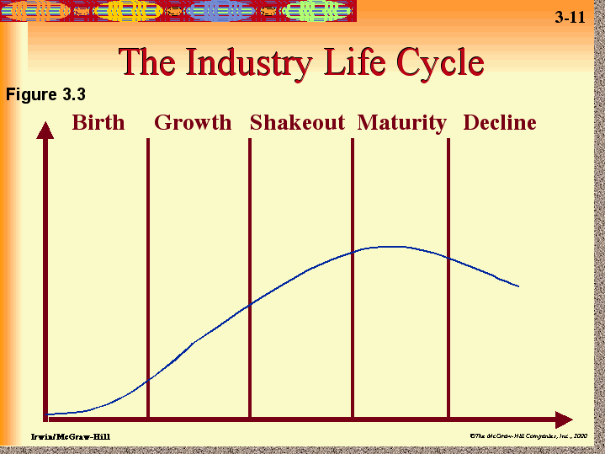

Slide 64
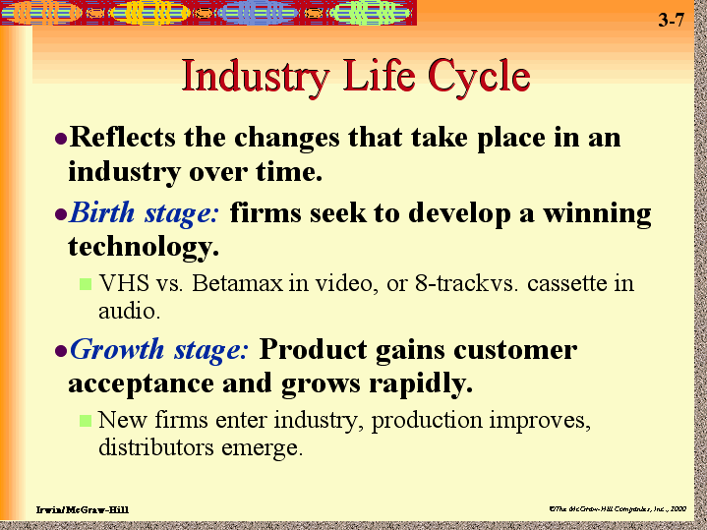

Slide 65
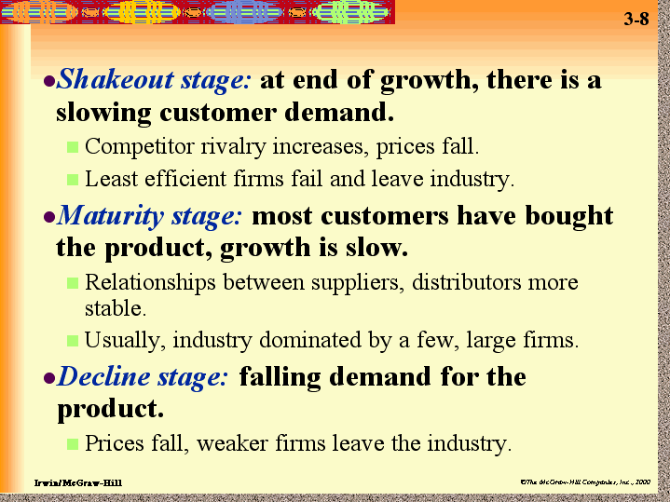

Slide 66
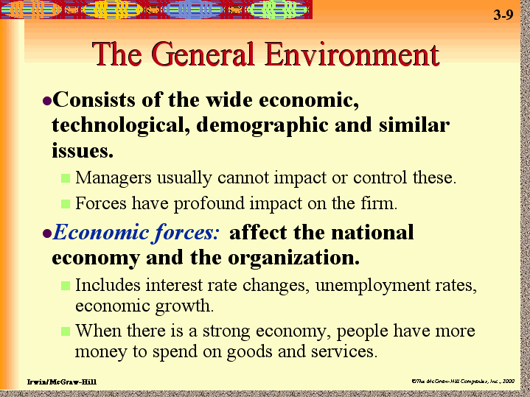

Slide 67
Economic Environment
National Income, GDP etc: production factors (labor [combination of physical & mental power, varies from unskilled labor to specialized skill], capital (mc, plant etc) and land & natural resource), production possibility curve opportunity cost,
Economic System: allocation of goods & services [what to yield, how to produce, to whom to be given] market (less control & price is determined from supply demand interaction), mixed, state governed (it determines the consumption pattern); [intervention is in the form of Prohibition [banning of demerit goods], Subsidy [merit goods are encouraged], Regulation [control on production & consumption]]
Employment & Unemployment:

Slide 68
The role of fiscal policy in economic development cannot be over emphasized. The importance of fiscal policy as an instrument of economic development was first envisaged by Keynes in his General theory wherein he showed that the total national income was an index of economic activity and brought out the relation of economic activity of total spending.

Slide 69
Cont with Economic Environment
Public Health: child mortality rate, more population in the lower age category result weaker work force
Education: specialized & skilled jobs can be there
Interest rate
Inflation rate & Government policy:
Securing the most efficient and fractional allocation of economic resources.
Accelerating the rate of capital formation.
Controlling inflation: Reduction in Government spending and no change in tax rates
Reduction in Government spending and increase in tax rates
Rigid Government spending and increasing tax rates
Reduction in Government spending and an equivalent reduction in taxes
Attaining and maintaining full employment.

Slide 70
Introduction
The Foreign Exchange Regulation Act (FERA) extends to whole of India including the State of Jammu & Kashmir. It further applies to all citizens of India living out of India. It also extends to all branches and agencies of companies and corporations working outside India but registered in India.

Slide 71
Objectives
Ensuring that all foreign exchange accruing to the country were properly accounted for.
To regulate certain payments.
To regulate import and export of currency.
To ensure proper utilization of the foreign exchange resources of the country for economic development.
To regulate holding of immovable property outside India.
To regulate foreign companies.

Slide 72
Introduction
The stock exchange or market is a place where stocks, shares and other long term commitment or investment are bought and sold.

Slide 73
Definition Stock Exchange as a “a association, organization or body of individuals, whether incorporated or not, established for the purpose of assisting, regulating and controlling, business in buying, selling and dealing in securities”.

Slide 74
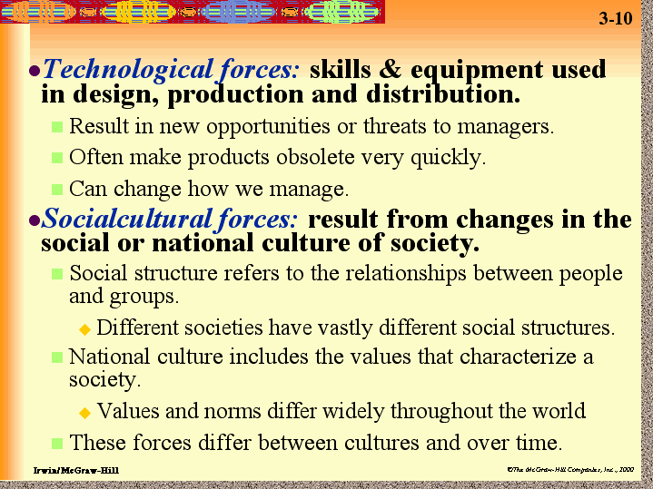

Slide 75
Impact of Technology change?
Improved products, new product, cost reduction for the process
Can yield very trifling Changes
Optical microscope to modern electronic microscope results valuable discoveries
Internet population got a saturated figure in Europe but gaining momentum in Asia Pacific countries

Slide 76
Market Structure and Technological Change
Bell company and its patent; available technology was very costly (due to the need of copper wires). Competition turned to monopoly
Micro wave technology brought threat for AT&T (when it was first offered its service to St Louise to Chicago)
Satellite and fiber optics have emerged

Slide 77
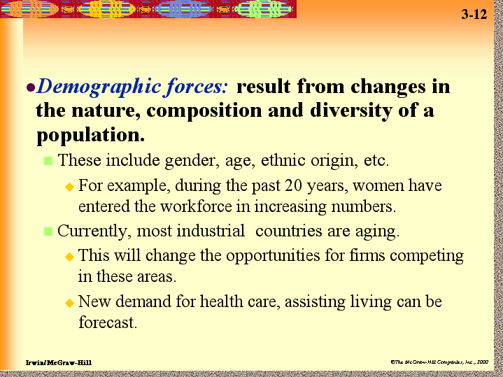

Slide 78
Demography means?
Estimated value of the population after one or more years
Trend shows the developed country like US has an increasing growth in higher age groups and lower birth rates. More wealth means more knowledgeable population, needs will be more

Slide 79
Role of Government in the Economy
Government performs the regulatory role. It regulates the economy through direct control and indirect control. The indirect controls are usually exercised through various fiscal and monetary policies. The direct controls over the economy include industrial licensing and price and distribution controls. The, government also controls the monopoly and unfair trade practices.

Slide 80
The government owns and controls the operation of business undertakings in the public sector. Public sector dominance is usually capital intensive industries like steel, fertilizers, petroleum etc. In such industries, the investment amount are very high, and returns period also too long.

Slide 81
Government Control Over Business
Economic Planning
Industrial Policy
Industrial Licensing
Labour Law
Regulation of Foreign Trade

Slide 82
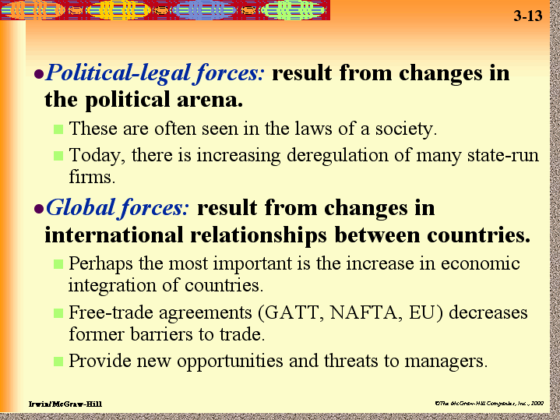

Slide 83
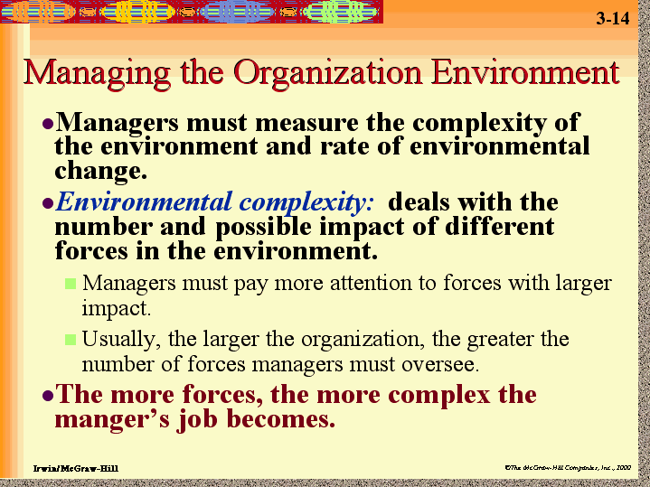

Slide 84
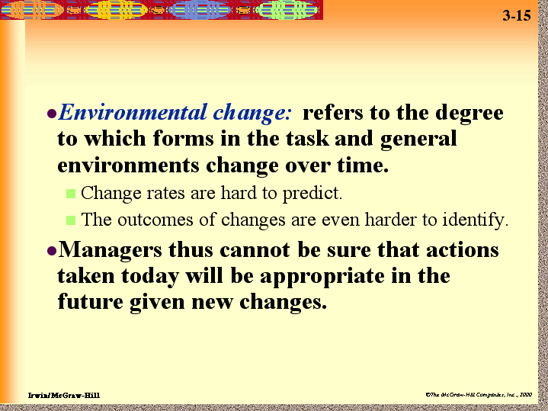

Slide 85
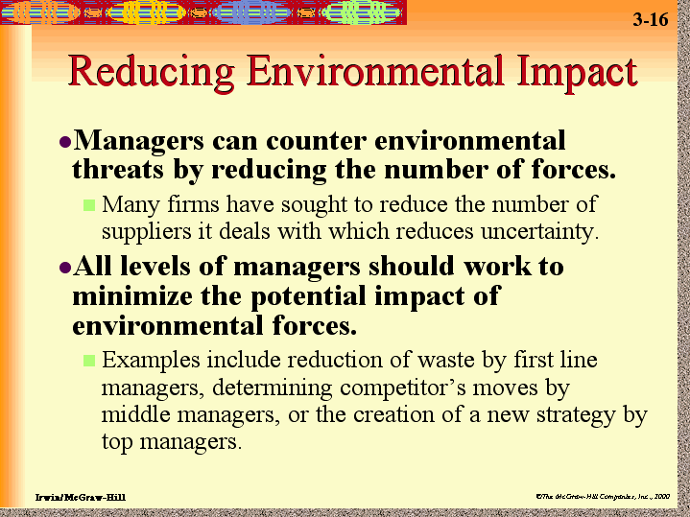

Slide 86
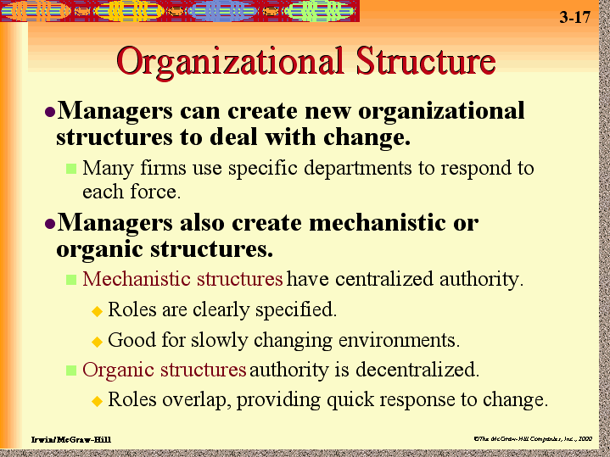

Slide 87
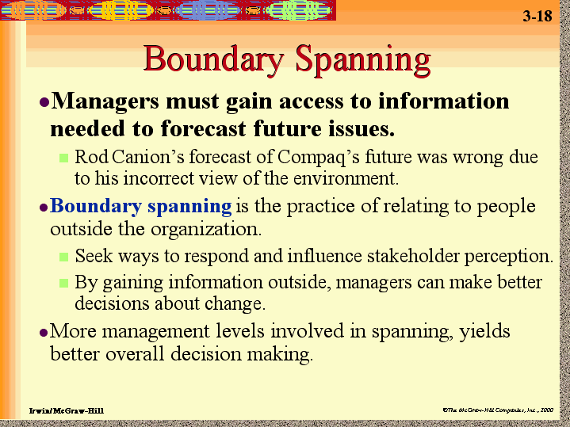

Slide 88
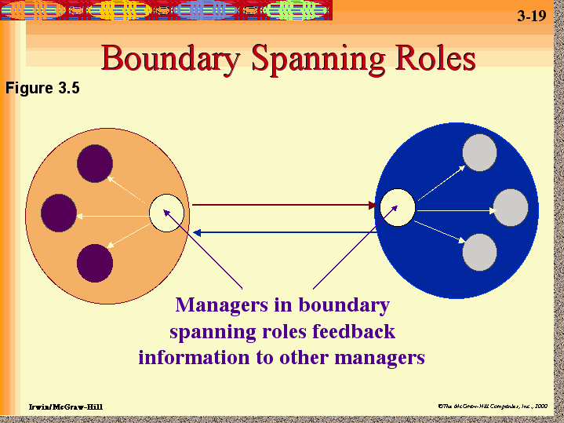

Slide 89
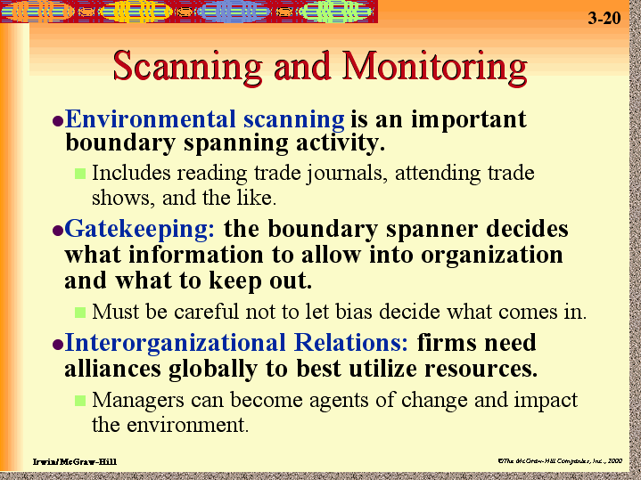

Slide 90
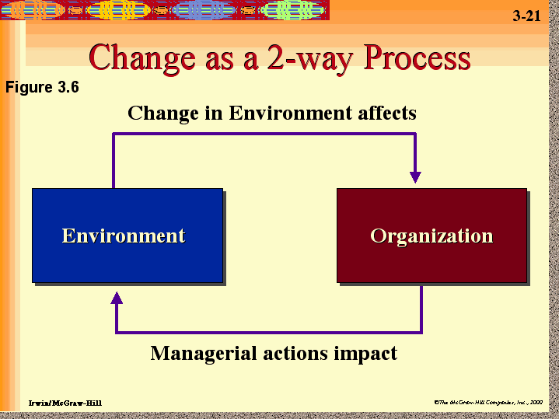

Slide 91
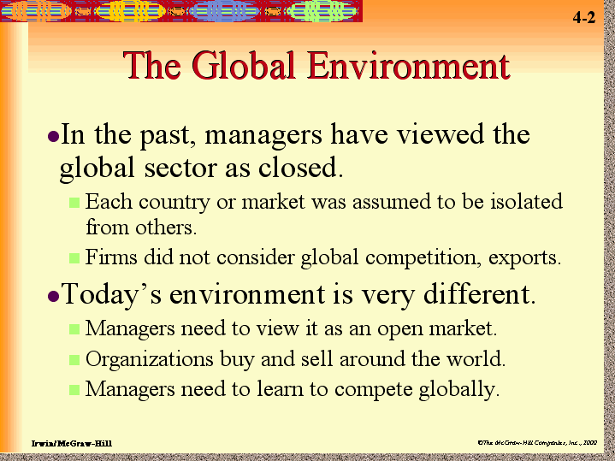

Slide 92
